Slide 1
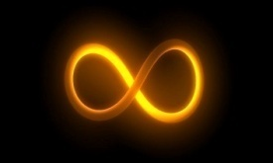
Tangents to a circle
There are four main properties of circle that we need to look at. One of these properties is the Tangent – Radius Property.
Tangent: a line that intersects a circle at only one point.
All of these are NOT tangents
IS A tangents
The place ( the point ) where the tangent intersects the circle is called the POINT OF TANGENCY
Notes:
1

Slide 2
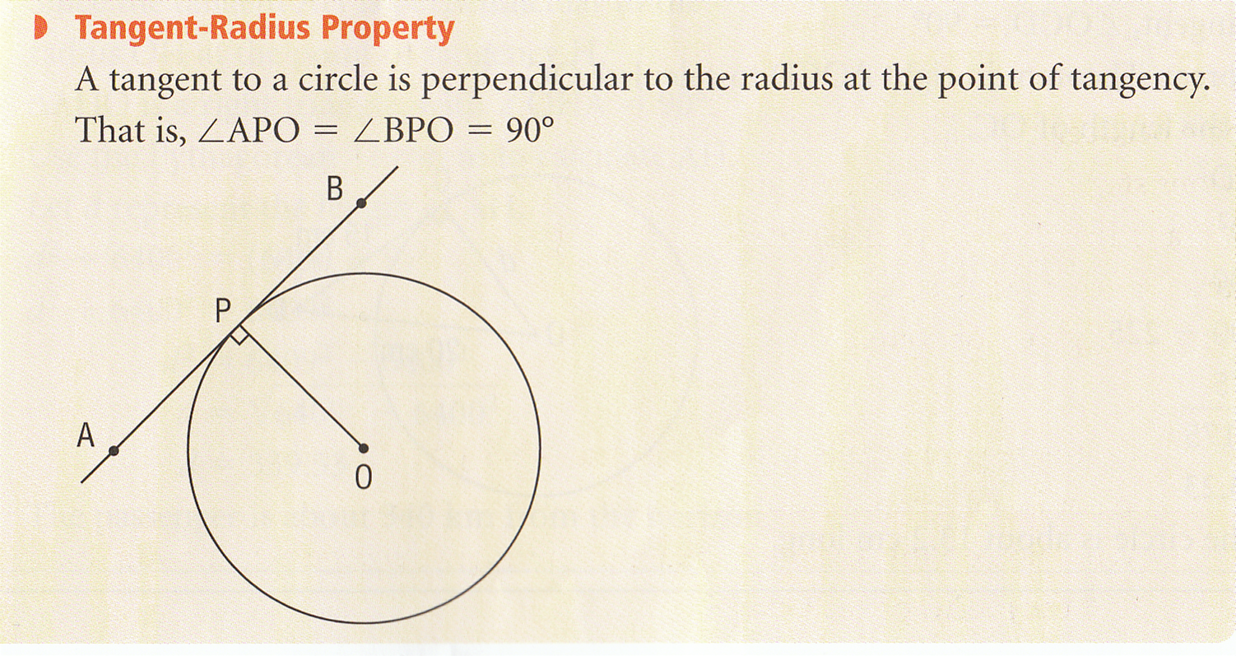
Tangents to a circle
There is a special relationship between the Point of Tangency and the radius of the circle. When these two meet it creates a perpendicular line with the Tangent and the Radius. This is known as the Tangent – Radius Property.
Pg 385: Math Makes Sense 9
Notes:
2

Slide 3
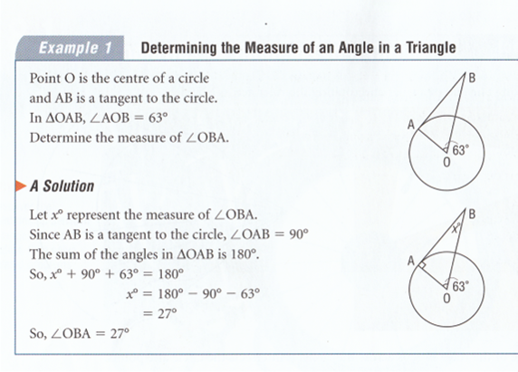
Tangents to a circle
Pg 386: Math Makes Sense 9
Notes:
3

Slide 4
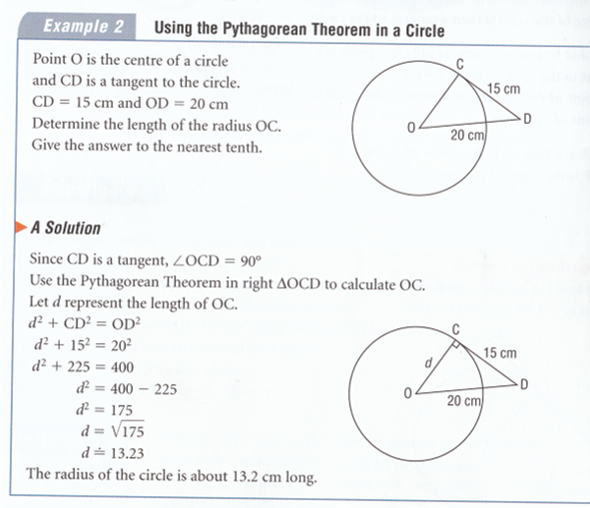
Tangents to a circle
Pg 386: Math Makes Sense 9
Notes:
4

Slide 5
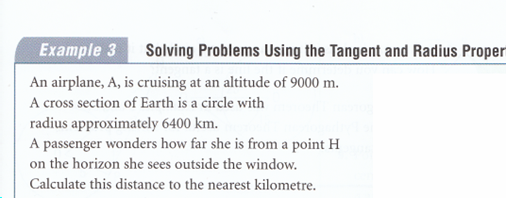
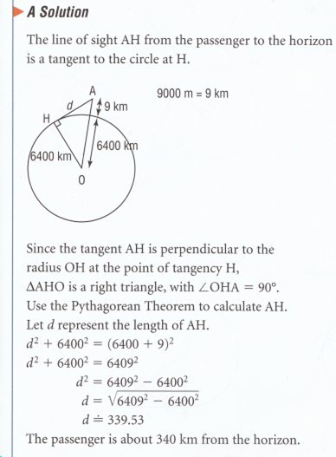
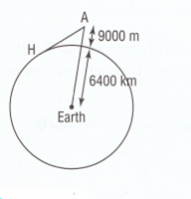
Tangents to a circle
Pg 387: Math Makes Sense 9
Notes:
5

Slide 6
Assessment
Pages
388 - 389
Numbers
3 – 9 , 12, 13, 14

Slide 7
Properties of Chords in a Circle
A line segment that joins two points on a circle is a chord. A diameter of a circle is a chord through the center of the circle.
The chord, its perpendicular bisector, and the center of the circle are related.
A perpendicular bisector intersects a line segment at 90⁰ and divided the line segment into two equal parts
Notes:
7

Slide 8
Properties of Chords in a Circle
Perpendicular to Chord Property 1
Pg 393: Math Makes Sense 9
Notes:
8

Slide 9
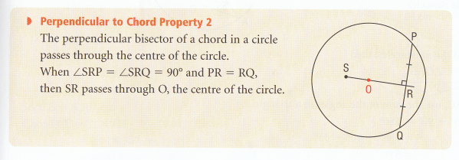
Properties of Chords in a Circle
Perpendicular to Chord Property 2
Pg 393: Math Makes Sense 9
Notes:
9

Slide 10
Properties of Chords in a Circle
Perpendicular to Chord Property 3
Pg 394: Math Makes Sense 9
Notes:
10

Slide 11
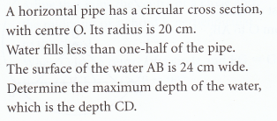
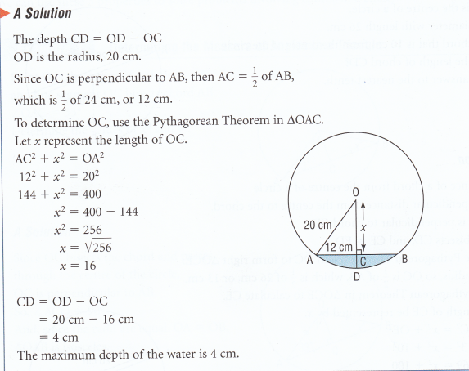
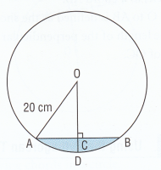
Properties of Chords in a Circle
Pg 396: Math Makes Sense 9
Notes:
11

Slide 12
Assessment
Pages
397 - 399
Numbers
3, 4, 5, 6, 7, 10
Possibly a`s one day b`s the next

Slide 13
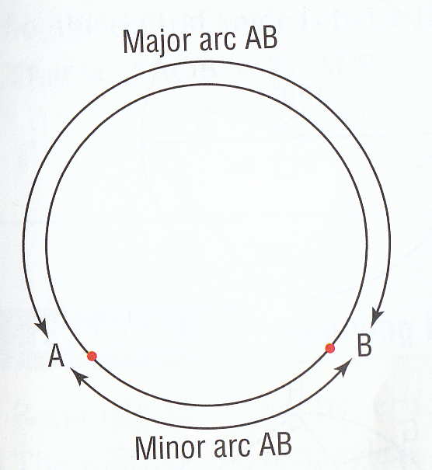
Properties of Angles in a Circle
The 2 points A and B create 2 Arcs
The shorter arc AB is the minor arc
The longer arc AB is the major arc
Pg 405: Math Makes Sense 9
Notes:
13

Slide 14
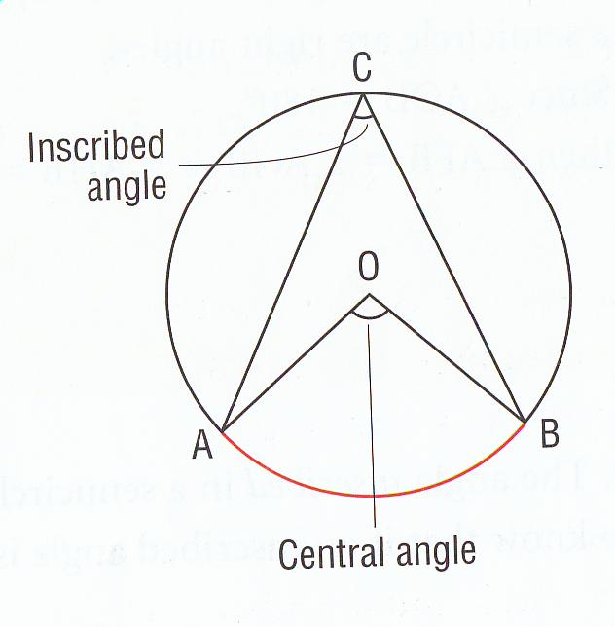
Properties of Angles in a Circle
Pg 405: Math Makes Sense 9
Notes:
14

Slide 15
Properties of Angles in a Circle
Pg 406: Math Makes Sense 9
Notes:
15

Slide 16
Properties of Angles in a Circle
Pg 406: Math Makes Sense 9
Notes:
16

Slide 17
Properties of Angles in a Circle
Pg 406: Math Makes Sense 9
Notes:
17

Slide 18
Assessment
Pages
410 - 412
Numbers
3, 4, 5, 6, 9, 11 plus worksheet

