Slide 1
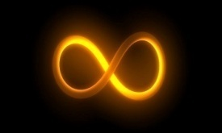
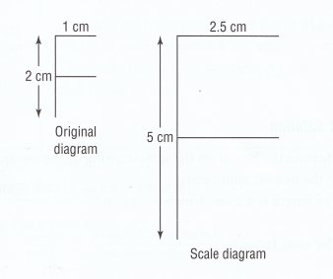
Scale Diagrams and Enlargements
Scale Diagram: is a diagram that is an enlargement or a reduction of another diagram
Compare the corresponding lengths in the scale diagram and in the original diagram.
Length of vertical segment of the scale diagram = 5
= 2.5
Length of vertical segment of the original diagram 2
Length of horizontal segment of the scale diagram = 2.5
= 2.5
Length of horizontal segment of the original diagram 1
In Math ,2 equal fractions are a proportion
Notes:
1

Slide 2
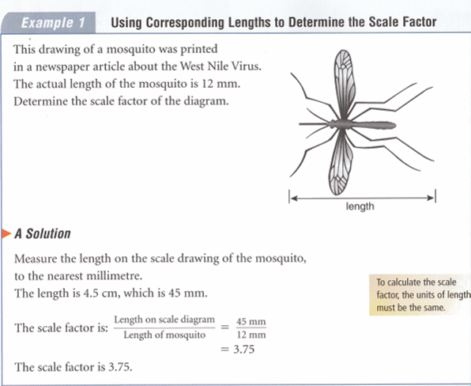
Scale Diagrams and Enlargements
Scale Factor: is the fraction of
Length of Scale Diagram
Length of Original Diagram
Pg320 : Math Makes Sense 9
Notes:
2

Slide 3
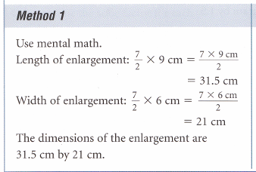
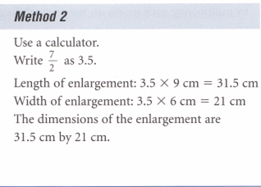
Scale Diagrams and Enlargements
Pg320 : Math Makes Sense 9
Notes:
3

Slide 4
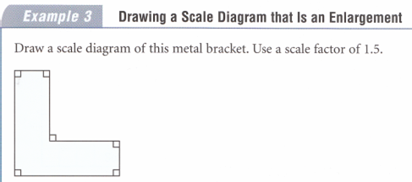
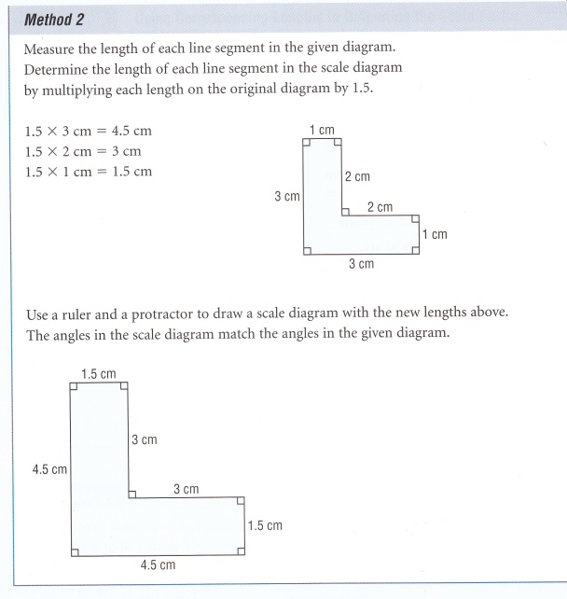
Scale Diagrams and Enlargements
NOTE: To calculate the scale factor, the units of lengths MUST be the same
Pg321 : Math Makes Sense 9
Notes:
4

Slide 5
Assessment
Pages
323 - 325
Numbers
4 – 8, 11, 12

Slide 6
Scale Diagrams and Reductions
Scale diagrams can also be smaller than the original diagram. There are call reductions.
We still use the same fraction to determine the scale factor.
Scale Factor: is the fraction of
Length of Scale Diagram
Picture
Length of Original Diagram
Real
Pg326 : Math Makes Sense 9
Notes:
6

Slide 7
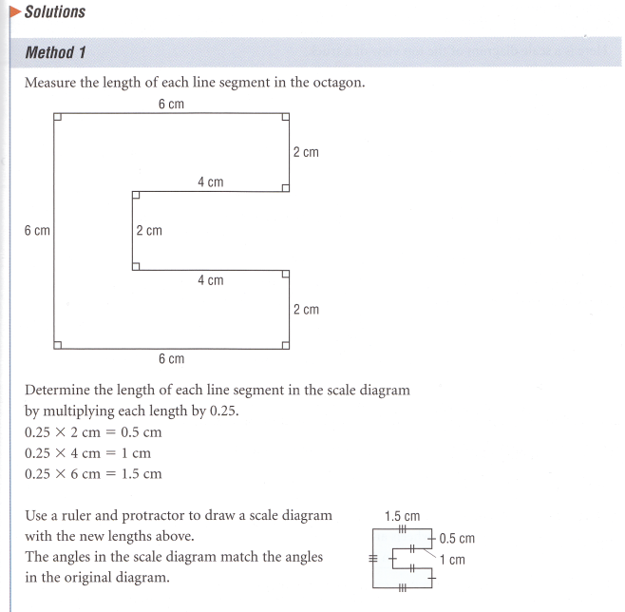
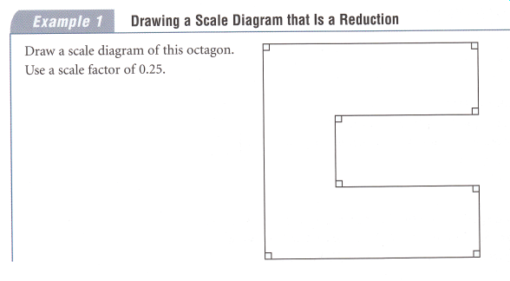
Scale Diagrams and Reductions
Pg327: Math Makes Sense 9
Notes:
7

Slide 8
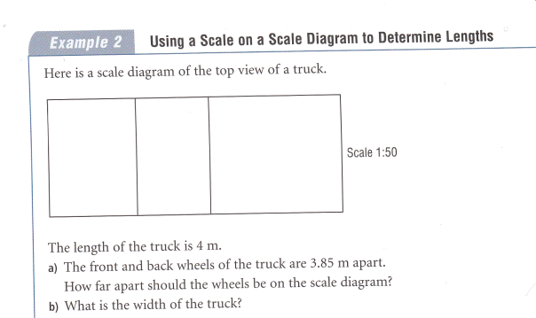
Scale Diagrams and Reductions
A Scale may also be written as a ratio. For example, if the scale diagram of a house is 1:150 it means that
1 cm on the diagram = 150 cm on the house
Pg328: Math Makes Sense 9
Notes:
8

Slide 9
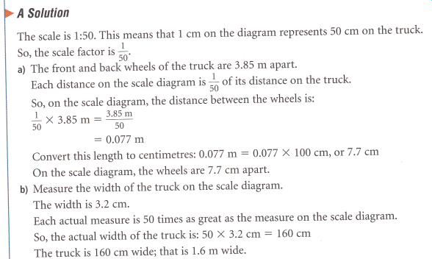
Scale Diagrams and Reductions
Pg328: Math Makes Sense 9
Notes:
9

Slide 10
Assessment
Pages
329
Numbers
4-8, 11, 12, 14, 16

Slide 11
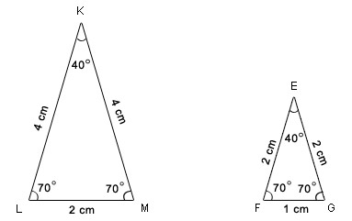
Similar Polygons
Similar:
Means that objects have the same shape but a different size
The angles are IDENTICAL
The side are NOT identical but are proportionate.
Note:
All angles are equal
Corresponding side have a scale factor of 2 - proportionate
Both are the same shape
~
KLM ~ EFG
Notes:
11

Slide 12
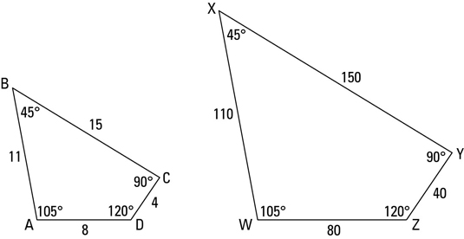
Similar Polygons
You can identify similar polygons by comparing their corresponding angles and sides. As you see in the following figure, quadrilateral WXYZ is the same shape as quadrilateral ABCD, but it’s ten times larger (though not drawn to scale, of course). These quadrilaterals are therefore similar .
Similar polygons: For two polygons to be similar, both of the following must be true:
Corresponding angles are congruent.
Corresponding sides are proportional.
Notes:
12

Slide 13
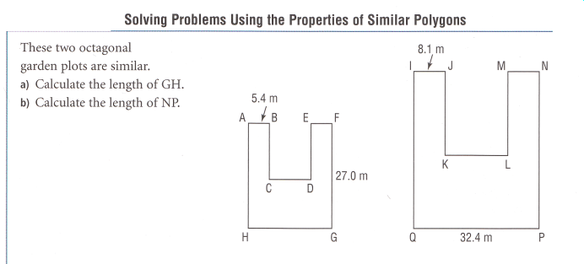
Similar Polygons
Example:
Notes:
13

Slide 14
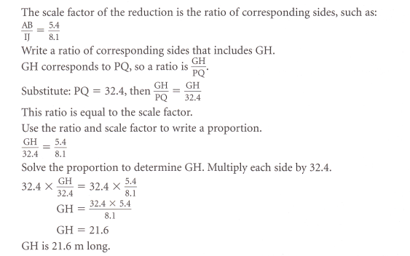
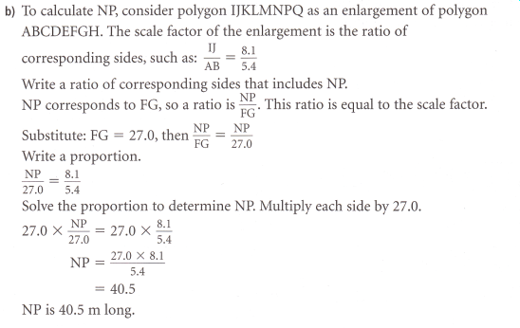
Similar Polygons
Solution
Notes:
14

Slide 15
Assessment
Pages
341 - 343
Numbers
4, 5, 7, 9, 11

Slide 16
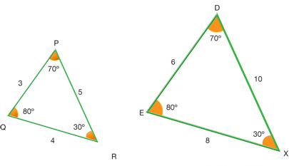
Similar Triangles
A common type of shape that is used with similar polygons are similar triangles. There are many practical applications in the real world.
In this example:
<Q = <E
<R = <X
<P = <D
~
AND
ED = DX = EX
= 2
QP PR QR
Notes:
16

Slide 17
Similar Triangles
This means that if we have some of the parts of the triangle we can find the other parts.
The first thing we have to be able to do is to find the similar triangles and to orient then to each other so all sides and angles correspond.
Already oriented properly
Notes:
17

Slide 18
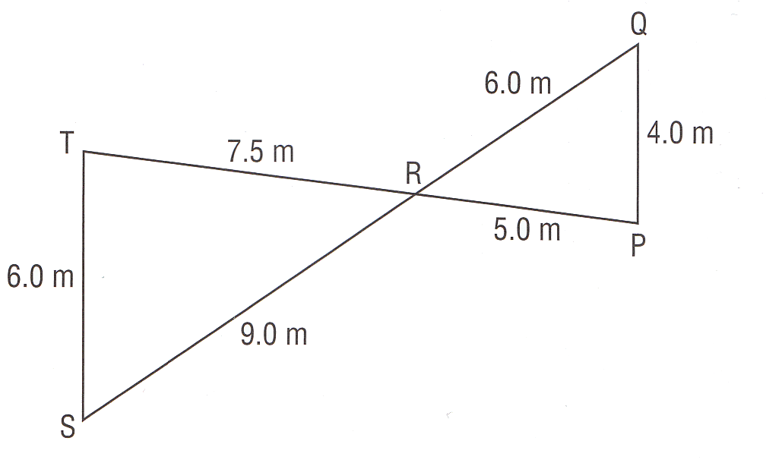
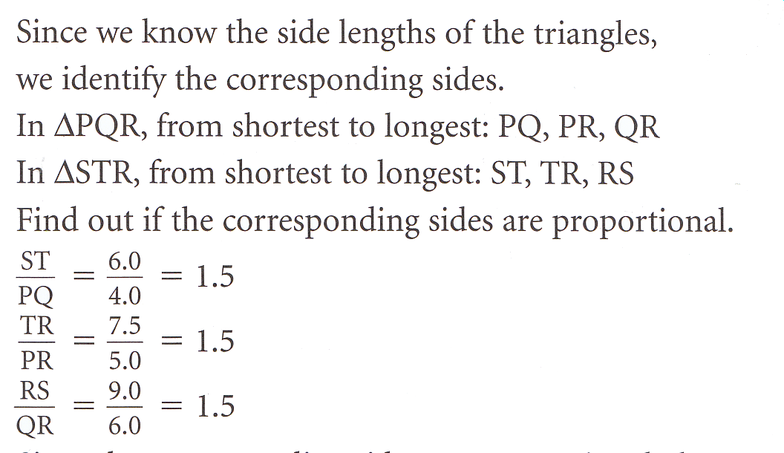
Similar Triangles
Notes:
18

Slide 19
Similar Triangles
Notes:
19

Slide 20
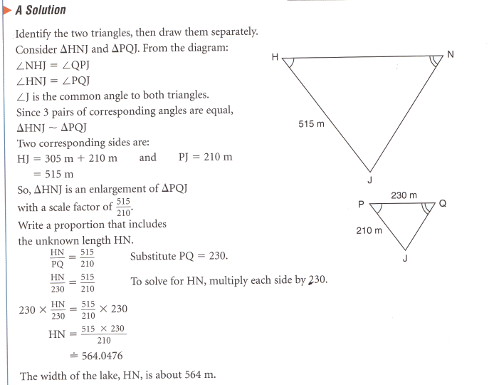
Similar Triangles
Notes:
20

Slide 21
Assessment
Pages
349 - 351
Numbers
4, 5, 6a, 7, 9, 10, 11, 12, 14

Slide 22
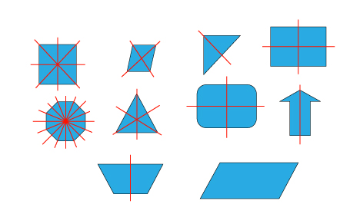
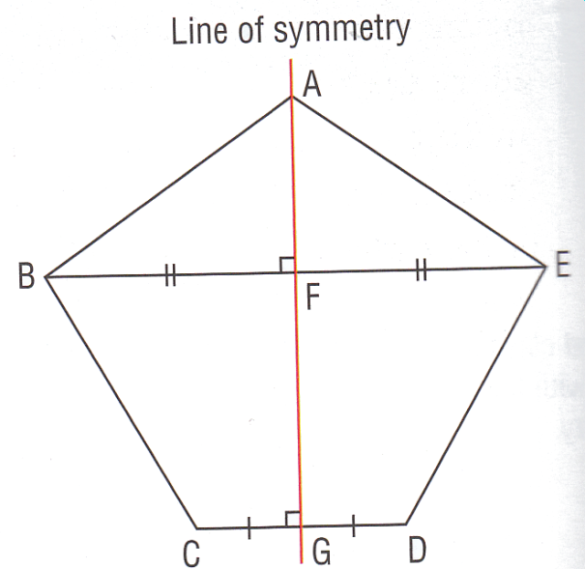
Lines of Symmetry and Reflections
Line of Symmetry: an imaginary line that divided a shape into 2 congruent parts so that the parts coincide perfectly when the shape is folded along the line of symmetry.
Examples:
Notes:
22

Slide 23
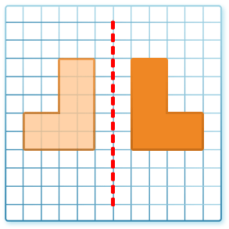
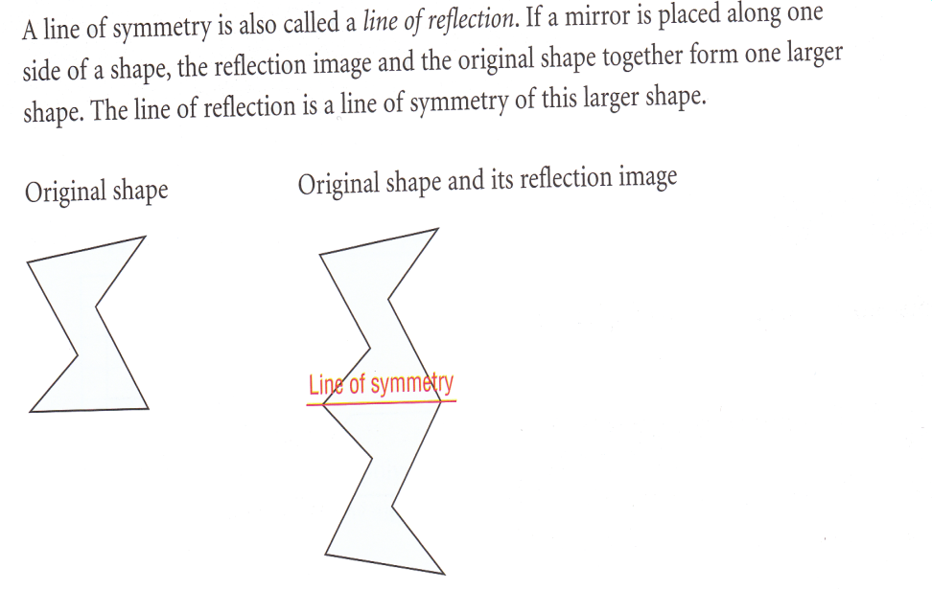
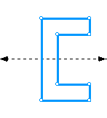
Lines of Symmetry and Reflections
A Line of Symmetry can also be called a line of reflection
Notes:
23

Slide 24
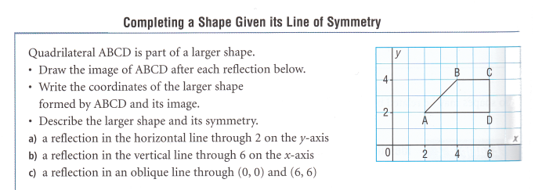
Lines of Symmetry and Reflections
Notes:
24

Slide 25
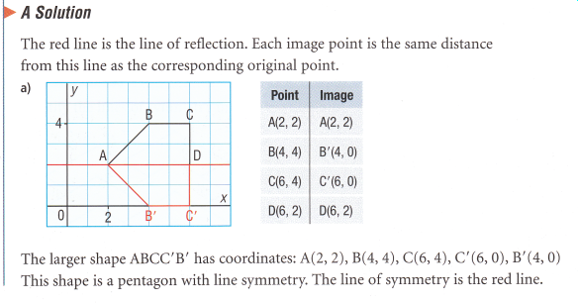
Lines of Symmetry and Reflections
Notes:
25

Slide 26
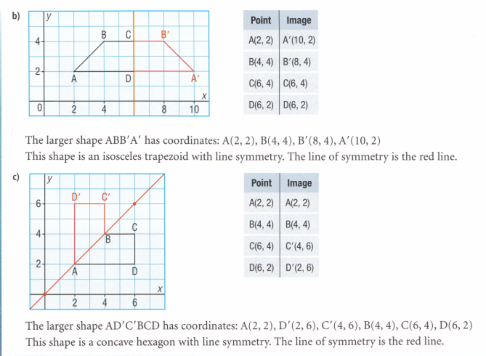
Lines of Symmetry and Reflections
Notes:
26

Slide 27
Assessment
Pages
357 - 359
Numbers
3, 5, 6a, 8, 9

Slide 28
Rotations and Rotational Symmetry
Rotational Symmetry
A shape has rotational symmetry when it coincides with itself (it overlaps itself) after a rotation of less than 360º about its centre.
Note that a shape that requires a rotation of 360º to return to its original position does not have rotational symmetry.
The number of times the shape coincides with itself, during a rotation of 360º, is the order of rotation.
A shape cannot have rotational symmetry of order 1 (it has to be at least 2).
Notes:
28

Slide 29
Rotations and Rotational Symmetry
The angle of rotation symmetry is the angle after which the shape coincides with itself. In general, for rotational symmetry, the angle of rotation symmetry is equal to :
angle of rotation symmetry = 360⁰
Order of rotation
Notes:
29

Slide 30
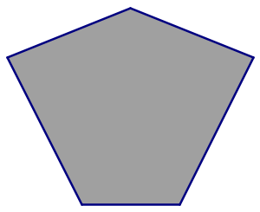
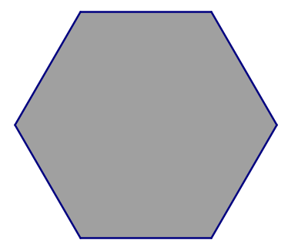
Rotations and Rotational Symmetry
State the order of rotation and the angle of rotation symmetry of the following shapes.
Rotational Symmetry of order 1
Rotational Symmetry of order 4
Angle of rotational symmetry
90⁰
Rotational Symmetry of order 6
Angle of rotational symmetry
60⁰
No Rotational symmetry
Angle of rotational symmetry
360⁰
Notes:
30

Slide 31
Assessment
Pages
365 - 367
Numbers
4, 5, 6, 7, 8, 9, 10, 12

Slide 32
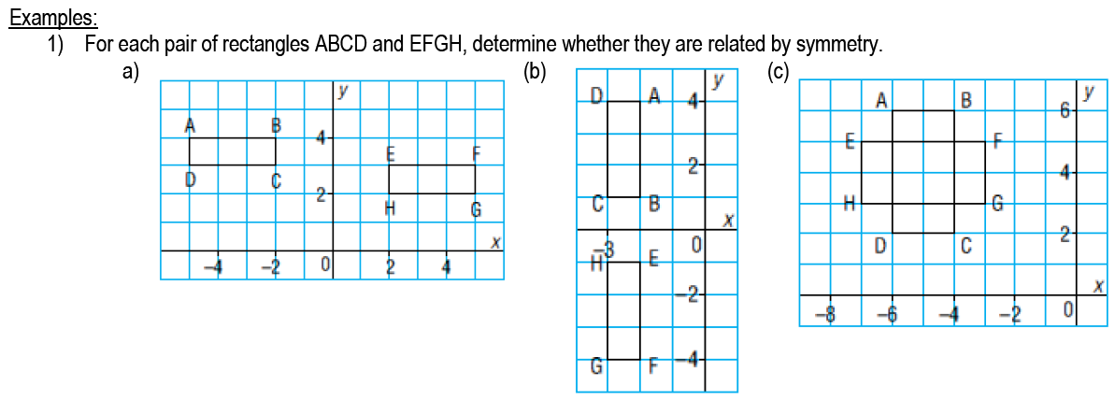
Identifying Types of Symmetry on the Cartesian Plane
We can use grid paper or square dot paper to perform rotations of 90⁰, 180⁰, 270⁰.
See this website:
http://staff.argyll.epsb.ca/jreed/9math/unit7/07.htm
Notes:
32

Slide 33
Identifying Types of Symmetry on the Cartesian Plane
Notes:
33

Slide 34
Assessment
Pages
373 - 375
Numbers
3, 5, 6, 7, 8, 10

