Slide 1
INTEGERS: Addition and Subtraction
Take a look at the understanding integers infographic. ☺
Adding Integers
When adding integers of the same sign, we add their absolute values, and give the result the same sign.
Example: -9 + -7 = -16 ⁺15 + ⁺12 = ⁺27
When adding integers of different signs, we take the sign of the largest number and then subtract the numbers
Example: -9 + ⁺7 = -2 ⁺15 + -16 = -1
Subtracting Integers
Subtracting an integer is the same as adding its opposite
Example: (-3) - (-5) = (-3) + (⁺5) = ⁺2
Notes:
1

Slide 2
INTEGERS: Multiplication and Division
Multiplying and Dividing Integers
From earlier grades, you remember that:
pos × pos = positive
neg × pos = negative
pos × neg = negative
neg × neg = positive
pos ÷ pos = positive
neg ÷ pos = negative
pos ÷ neg = negative
neg ÷ neg = positive
Notes:
2

Slide 3
Assessment
Worksheet:
FA 2-1

Slide 4
Pre-Assessment
Fractions, Decimals, and Percents
Always, Sometimes, Never

Slide 5
Rational Numbers
Rational Numbers are numbers that can be written as the quotient of 2 integers. In the Form a/b where a is any integer and b is any integer except 0
Examples of Rational Numbers:
a) All fractions and mixed numbers
b) All integers such as 8 which is 8/1 or -4 which is -4/1
c) All terminating and repeating decimals such as 0.7 which is 7/10 or 0.3⁻ ( repeating) which is 1/3

Slide 6
Irrational Numbers
Numbers that can not be written as a quotient of two integers are called irrational numbers. These numbers are non-repeating (never repeat a pattern), non-terminating (never ending) decimals.
Example :
1) the square root of 2
2) pi ( 3.14…)
PLEASE NOTE: any number with the denominator of 0 is considered neither Rational or Irrational Numbers and called undefined.

Slide 7
Rational or Irrational?
Rational
Irrational
15
5/2
-4
1½
7.2542542542…
2√3
2.3333…
√2
2³
- 4.3458924

Slide 8
Addition of Fractions
Like Fractions are those having the same denominator
Examples: 2/5 and 4/5. To add like fractions, add the numerators and use the sum as the numerator of a new fraction having the same denominator. For example:
2 + 2 = 2+2 = 4
5 5 5 5
If the numerator and denominator in the result can both be divided by some number greater than 1, the fraction can be reduced by doing this division until both its terms are unable to be divided by a common number
1 + 3 = 1 + 3 = 4 . But 4 = 4 ÷ 2 = 2
10 10 10 10 10 10÷2 5

Slide 9
Addition of Fractions
Examples:
1 + 2 3 + 11
4 4 7 7

Slide 10
Addition of Unlike Fractions
To add fractions whose denominators are not the same, first find the Lowest Common Denominator , LCD for the fractions. This is the least common multiple, LCM, of the given denominators. Then for each fraction, divide the LCD by that fraction’s denominator, and multiply both terms of the fraction by the resulting number. This changed the fraction to one having the LCD. Then add as with like fractions. For example,
2 20 ÷ 5 = 4 4 x 2 = 8
5 4 x 5 20
20(LCD) 8 + 15 = 23 or 1 3/20
20 20 20
3 20 ÷ 4 = 5 5 x 3 = 15
4 5 x 4 20

Slide 11
Addition of Unlike Fractions
Determine the LCD between the following two number:
a) 3 and 5 b) 2 and 7 c) 8 and 20

Slide 12
Addition of Unlike Fractions
Add the unlike fractions below:
4 + 1
5 10
Find the LCD
Divide the LCD by fractions denominator
Multiply both terms of the fraction by the resulting number. (Now you have like fractions)
Add like fractions.
b) 2 + 3
6 7
2
c) 2 + 1
3 4

Slide 13
Adding Unlike Fractions
How confident do you feel about adding unlike fractions?
6
5
4
3
2
1

Slide 14
Activity
Operations (adding) with rational numbers wheel
Partner Activity

Slide 15
Subtraction of Fractions
If the fractions have the same denominator, subtract one numerator from the other and use the result as the numerator of a new fraction, leaving the denominator unchanged.
7 - 3 = 7 - 3 = 4 , and simplifying 4 = 4 ÷ 4 = 1
8 8 8 8 8 8 ÷ 4 2
If the fractions have different denominators, first change each fraction to having the least common denominator, LCD . Then create equivalent fractions and subtract as done above.
5 12 ÷ 6 = 2 2 x 5 = 10
6 2 x 6 12
12(LCD) 10 - 3 = 7
12 12 12
1 12 ÷ 4 = 3 3 x 1 = 3
4 3 x 4 12

Slide 16
Subtraction of Fractions
a) 4/5 – 2/3 b) 2/7 – 2/9

Slide 17
Subtraction of Fractions
a) 1 1/3 – 2/3 b) 2 ¼ - ½

Slide 18
Fraction Centers
Groups of 3
What is a fraction?
Adding fractions
Subtracting fractions
Ordering fractions

Slide 19
Assessment
Assessment : FA2-3a, FA2-3b, FA2-3c
Pages
111-113 and 119-120
Numbers
3,4,9,and 13
7,15

Slide 20
Pre-Assessment
Process Detectives
Multiplying and Dividing Fractions

Slide 21
Multiplication of Rational Numbers
Multiply the numerators
Multiply the denominators
Reduce, Reduce, Reduce
7 x 4 = 7 x 4 = 28 , simplifying 28 = 28 ÷ 4 = 7
8 5 8 x 5 40 40 40 ÷ 4 10
To reduce use the greatest common factor of the numerator and denominator.
NOTE: NEVER WORK WITH MIXED NUMBERS ALWAYS CONVERT TO IMPROPER FRACTIONS

Slide 22
Multiplication of Rational Numbers
Multiply the following rational numbers:
2 x 4
3 5
b) 1 x -5
2 10
Multiply the numerators
Multiply the denominators
Reduce, Reduce, Reduce
To reduce use the greatest common factor of the numerator and denominator.
NOTE: NEVER WORK WITH MIXED NUMBERS ALWAYS CONVERT TO IMPROPER FRACTIONS
2
c) 2 x 1
3 4

Slide 23
Multiplication of Rational Numbers
Reduce the following rational numbers:
2/40
4/12
9/30
20/52
Multiply the numerators
Multiply the denominators
Reduce, Reduce, Reduce
To reduce use the greatest common factor of the numerator and denominator.
NOTE: NEVER WORK WITH MIXED NUMBERS ALWAYS CONVERT TO IMPROPER FRACTIONS

Slide 24
Multiplication Task Cards
Multiply the numerators
Multiply the denominators
Reduce, Reduce, Reduce
Multiplying Fractions Task Cards:
Solve all the problems individually or with a partner. Both members must show all their work and circle the final answer.
To reduce use the greatest common factor of the numerator and denominator.
NOTE: NEVER WORK WITH MIXED NUMBERS ALWAYS CONVERT TO IMPROPER FRACTIONS
OR Multiplication and Division Word Problems Task Cards

Slide 25
Division of Fractions
Leave the first fraction
Change the ‘÷’ sign to a ‘x’ sign
Change the second fraction to its reciprocal .
2 ÷ 4 = 2 x 5 = 10 , simplifying 10 ÷ 2 = 5
3 5 3 4 12 12 ÷ 2 6
If mixed numbers are involved, ALWAYS change to improper fraction before you perform any operation.

Slide 26
Division of Fractions
Divide, reduce if necessary:
Leave the first fraction
Change the ‘÷’ sign to a ‘x’ sign
Change the second fraction to its reciprocal .
2 ÷ 4
3 5
b) 1 ÷ -5
2 10
If mixed numbers are involved, ALWAYS change to improper fraction before you perform any operation.
c) 2 ÷ 1
3 4
2

Slide 27
Multi/Div of Rational Numbers
Example :
(-0.64) x (0.2)
= - 0.128
b) (-3.9) ÷ (1.5)
= -2.6
Addition and Subtraction of DECIMALS Review
Notes:
27

Slide 28
Assessment
Assessment : FA2-4a
Pages
127 - 129 (5, 9, 10, 11, 14)
Pages
134-136 (9, 11, 15, 17ac )
Assessment : FA2-4b
Assessment : FA2-4c
Mult and Div Rational Numbers WORKSHEET

Slide 29
Activity
Fractions of the Day
Choose two fractions between 1/7 and 7/8 and complete the provided worksheet. You have 10 minutes! ☺

Slide 30
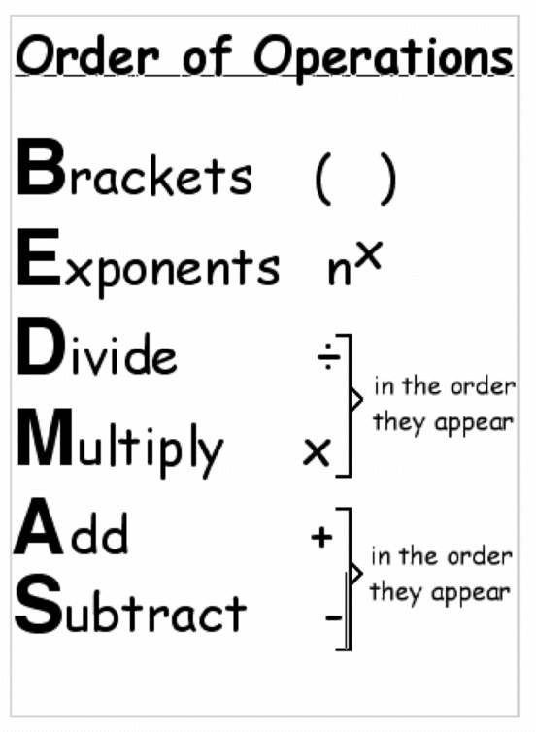
Order of Operations
Notes:
30

Slide 31
You Try:
Solve the following:
b) 2 x 1 + 2 ÷ 4
9 3 3 7
2 + 1 x 4
9 3 3
(
)

Slide 32
Assessment
Order of Operations with Rational Numbers WORKSHEETS
Assessment : FA2-5

Slide 33
Calculator Usage
All calculators are different. Make sure you get familiar with your specific model.
a) 20 + 30 ÷ 2
= 20 + 15
= 15
Try the same question with your calculator.
You should notice that your calculator seems to know the order of operations
b) 96 – 3(4.2 – 0.2)
= 96 – 3(4)
= 96 – 12
= 84
NOTE: You must type x between the 3 and the bracket
Notes:
33

Slide 34
Assessment
Order of Operations with Calculator and Rational Numbers WORKSHEETS(2)
Assessment : FA2-6a
Assessment : FA2-6b

Slide 35
Perfect Squares
A square number, sometimes also called a perfect square, is an integer that is the square of an integer. In other words, it is the product of some integer with itself.
So 9 is a square number, since it can be written as 3 × 3.
It also can be drawn as an actual square
3
Numbers such as 1, 4, 9, 16, 25 are examples of Perfect squares (square numbers) because they can be written as a product of two identical integers.
5
3
A = 9
5
A = 25
Notes:
35

Slide 36
Perfect Squares
List the perfect squares from 1-225:
1² =
2² =
3² =
4² =
5² =
6² =
7² =
8² =
9² =
10² =
11² =
12² =
13² =
14² =
15² =
.
Notes:
36

Slide 37
Square Roots
A square root is the opposite process to squaring a number. A square root can be found if you can write the perfect square number as a product of itself.
√25 can be written as √5 x 5
so therefore the
√25 is 5
Notes:
37

Slide 38
Square Roots
Decimals and fractions can also be perfect squares
√2.25 = √ 1.5 x 1.5 = 1.5
√ 9/25 = √ 3/5 x 3/5 = 3/5
Notes:
38

Slide 39
Square Roots - Example
Determine if 8/18 is a Perfect Square
Note: At first glance it does not appear to be a perfect square – 8 is not nor is 18
√
8
Always reduce fractions
18
√
4
9
Product of two equal fractions
√
4
2
=
x
2
√
9
3
3
This means that 8/18 is a perfect square
=
2
3
Notes:
39

Slide 40
Square Roots - Example
Determine if 6.25 is a Perfect Square
Determine if the square root of .64
√
.64
√
6.25
√
.8 x .8
=√
625
= 0.8
Terminating decimals
100
=√
25
4
Product of two equal fractions
5
=
2
Notes:
40

Slide 41
Assessment
Pages
11
Numbers
4 -9
Assessment : FA2-7

Slide 42
Square Roots of Non Perfect Squares
With all numbers that are not PERFECT SQUARES, we can only find an estimate answer.
Example
With ten tiles we can not a perfect square shape.
Here we need to use BENCHMARKS
√
10
9
16
3
3.1
4
Notes:
42

Slide 43
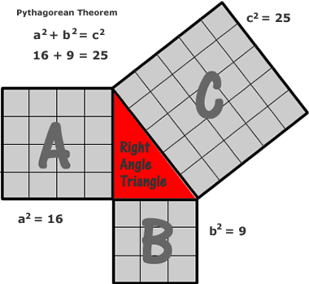
Squares and Pythagorean Theorem
Pythagorean theorem gives us the relation between the three sides of a right triangle.
It states that:
"The sum of the squares of the two legs of a right triangle is equal to the square of the hypotenuse of the right triangle"
Pythagorean Theorem: a² + b² = c²
Notes:
43

Slide 44
Assessment
Pages
18-20
Numbers
4ab, 5ab, 11, 12, 13
Next day Page 21 - all
Assessment : FA2-8a
Assessment : FA2-8b

Slide 45
Activity
Pythagorean Theorem
Partner Practice
Worksheet and Reflection

Slide 46
Number Systems
The number system has been broken down into the following
Natural Numbers N = {1,2,3,4…}
Whole Numbers W = {0,1,2,3,…}
Integers I = { … -3,-2,-1,0,1,2,3…}
Rational Numbers Q
Rational numbers include all natural, whole and integer numbers as well as all fractions ( in between the integers)
A rational number must be able to be expressed in the form
a/b where b = 0
All terminating and repeating decimals are rational numbers
Notes:
46

Slide 47
Number Systems
What is not a rational number?
Irrational Numbers Q are
Non ending and non repeating decimals.
Example: Numbers such as
√
π
3
18.98232……. Never ending and never repeating
Notes:
47

Slide 48
Number Systems
Notes:
48

Slide 49
Assessment
Rational Numbers WORKSHEETS
Assessment : FA2-9

Slide 50
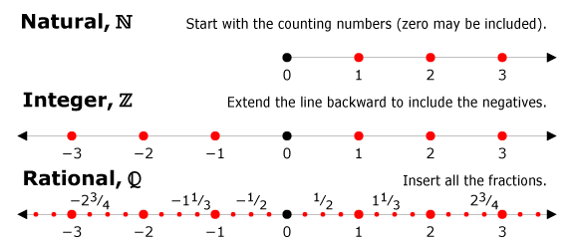
Compare {Q}
No matter how close 2 rational numbers are, there is always a rational number in between them.
x > 3 {I}
x > 3 {Q}
All numbers in between the integers
Notes:
50

Slide 51
Compare {Q}
Example 1 : Find 2 rational numbers between each pair of numbers.
-6 and -2
The numbers would be -3, -4, and -5
As well as -2.5, - 3.5, -4.5, -5.5
As well as -2.1, -2.2, -2.3 ……
As well as -2.11, -2.12, - 2.13…..
As you can see there are an infinite amount of rational numbers between these 2
Notes:
51

Slide 52
Compare {Q}
Example 2: Find 2 rational numbers between each pair of numbers.
4.3 and 4.4
4.35
4.37
4.3
4.4
Example 3: Find 2 rational numbers between each pair of numbers.
11/5 and 14/5
1
1 1/5
1 2/5
1 3/5
1 4/5
2
Notes:
52

Slide 53
Compare {Q}
Example 4: Find 2 rational numbers between each pair of numbers.
-21/3 and -12/5
-12/5
-21/3
-2
-12/3
-11/3
-1
Lots to choose from!
OR
-21/3
and
-12/5
Making the rational number with a common denominator will help you in knowing what number fall in between
-7
3
-7
5
-35
15
-21
15
Choose from in between here
Notes:
53

Slide 54
Ordering {Q}
Ordering from least to greatest can be difficult when you need to order fractions and decimals.
Example using fractions.
a) -3/8, 5/9, -10/4, -11/4, 7/10, 8,3
-10/4
-11/4
-3/8
5/9
8/3
7/10
Steps:
First decide which whole numbers you need
Some are positive and some are negative
None is bigger than +3 or less the -3
Notes:
54

Slide 55
Ordering {Q}
Example using fractions and decimals.
a) 1.13, -10/3, -3.4, -2.7, 3/7, -22/5
Steps:
May be easiest to convert all to decimals before starting. Unless some are common sense.
Solution - -3.4, -10/3, -22/5, 3/7, 1.13, 2.7
Notes:
55

Slide 56
Assessment
Pages
101-103
Numbers
5, 6, 7, 8, 10, 12ace, 14ace, 15, 21, 23a, 24c, 25ab
Assessment : FA2-10

