Slide 1
Solving Single Operation Equations
Expressions and equations are similar.
Expression
x+ 5
Equation
x+ 5 = 10
In an expression “x” can be anything
In an equations “x” will have only a specific value (has an equal sign)
Notes:
1

Slide 2
Solving Single Operation Equations
Equality is the state of being quantitatively the same . For example
4 + x = 9 means the Left side is the same value as the Right side.
Inequality is also the state of being quantitatively the same . However more than one answer will satisfy the equation.
For example:
4 + x > 9 > mean greater than
4 + x < 9 < means less than
4 + x ≥ 9 ≥ means greater than or equal to
4 + x ≤ 9 ≤ means less than or equal to
Notes:
2

Slide 3
Solving Single Operation Equations
A like term is a term with the same variable and degree
Example: 3x, 7x and -3x are all like terms
Unlike terms are terms such as 4, 3x and 2x²
Like terms can be added or subtracted, whereas unlike terms can not.
Notes:
3

Slide 4
Solving Single Operation Equations
Critical Concepts:
When solving equations, whatever operation is performed on one side of the equation, this same operation must be performed on the other. To keep the sides of the equation balanced, any type of operation may be performed as long it is performed to both sides.
Example:
x + 3 = 5
-3 -3
x = 2
Pictorially
Notes:
4

Slide 5
Solving Single Operation Equations
Examples:
a) x-3=10
Verify
b) 2x=8
Verify
c) x =5
Verify
x-3=10
13-3=10
10=10
LS=RS
÷2 ÷ 2
2x=8
2(4)=8
8=8
LS=RS
3
+3 +3
x =5
(3)
3
x =4
3
x =13
x =15
d) x + ½ =15/6
Verify
x + ½ - ½ = 11/6 - ½
x = 11/6 – 3/6
x = 8/6
x = 1 1/3
e) x +5 >7
Verify
Means any number larger than 2 would make this inequality true
x +5-5 >7-5
x > 2
Notes:
5

Slide 6
Assessment
Pages
280
Numbers
4(ab), 6, 7, 8, 9, 10, 11, 12, 13, 15, 17, 19, 21

Slide 7
Solving Multi Operation Equations / Inequalities
Examples:
Pictorially
Tiles
a) 2x+3= 9
Verify
2x+3-3= 9-3
2x = 6
2 2
x = 3
b) 2x+3x= 10
c) 5x-3 ≥ 22
5x = 10
5x-3+3 ≥ 22+3
5x = 10
5x ≥ 25
5 5
5 5
x = 2
x ≥ 5
Notes:
7

Slide 8
Solving Multi Operation Equations / Inequalities
Examples:
d) 3x - 7x < 16
-4x < 16
-4x < 16
-4 -4
x > -4
NOTE: THE INEQUALITY CHANGED AS WE DIVIDED BY A NEGATIVE
Notes:
8

Slide 9
Assessment
Worksheet

Slide 10
Solving Multi Operation Equations / Inequalities
Examples:
a) 3x + 20 = 5x + 10
3x + 20 -20 = 5x + 10 - 20
3x = 5x -10
3x – 5x = 5x -5x -10
-2x = -10
-2 -2
x = 5
Notes:
10

Slide 11
Solving Multi Operation Equations / Inequalities
Examples:
b) -14x > -5x - 9
-14x +5x > -5x +5x - 9
-9x > - 9
-9 -9
x < 1
NOTE: THE INEQUALITY CHANGED AS WE DIVIDED BY A NEGATIVE
Notes:
11

Slide 12
Assessment
Worksheet

Slide 13
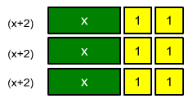
Distributive Property
The Distributive Property states that multiplying a sum by a number is the same as multiplying each addend by the number, then adding the products.
x
3( x + 2 ) = 3x + 6
x
Notes:
13

Slide 14
Distributive Property
Examples:
2( x - 3)
2x -2(3)
2x - 6
4( 3x +2 )
4(3x) + 4(2)
12x + 8
-2( -3x - 2 )
-2(-3x) – (-2)(2)
6x + 4
-3(x² - 5x - 2) - 4(3x² - 3x + 3)
-3(x²) – (-3)(5x) - (-3)(2) - 4(3x²) - (-4)(3x) + (-4)(3)
-3x² +15x +6 - 12x² +12x -7
- 15x² +27x -1
Notes:
14

Slide 15
Assessment
Worksheet

Slide 16
Solving Equations and Inequalities using the Distributive Property
Examples:
Verify
-3(5x - 2) – 8 = 28
-15x + 6 – 8 = 28
-15x -2 = 28
-15x -2 + 2 = 28 + 2
-15x = 30
-3(5x - 2) - 8 = 28
-3(5(-2) - 2) - 8 = 28
-3(-10 – 2) -8 =28
-3(-12) – 8 = 28
36 - 8 = 28
28 = 28
LS = RS
-15 -15
x = -2
Notes:
16

Slide 17
Solving Equations and Inequalities using the Distributive Property
Examples:
Verify
4(-3x + 5 ) + 16 ≥ 2 (4x – 6) – 12
-12x + 20 + 16 ≥ 8x -12 -12
-12x + 36 ≥ 8x – 24
-12x + 35 - 36 ≥ 8x – 24 – 36
-12x ≥ 8x – 60
-12x -8x ≥ 8x - 8x – 60
-20x ≥ -60
4(-3x + 5 ) + 16 ≥ 2 (4x – 6) – 12
4(-3*3 + 5 ) + 16 ≥ 2 (4*3 – 6) – 12
4(-9 + 5 ) + 16 ≥ 2 (12 – 6) – 12
4(-4) + 16 ≥ 2(6) – 12
-16 + 16 ≥ 12 – 12
0 ≥ 0
-20 -20
NOTE: THE INEQUALITY CHANGED AS WE DIVIDED BY A NEGATIVE
x ≤ 3
Notes:
17

Slide 18
Assessment
Worksheet

Slide 19
Solving Equations of form a/x = b , where b can not be 0
Examples:
15 = 5
b) 8= 2
x
x
*x *x
15 = 5x
*x *x
8 = 2x
5 5
2 2
3 = x
4 = x
Notes:
19

Slide 20
Solving Equations involving fractions and decimals
Clear Fractions
Examples:
5 x – 2 1 = 2 2
5 x – 2 1 = 2 2
3
6
3
6
3
3
Normal way of moving over the fractions, than multiplying by the coefficients reciprocal
OR
5 x – 7 = 8
*6
*6
6
3
3
*2
*2
5x – 14 = 16
5x – 14 + 14 = 16 + 14
5x = 30
5
5
x = 6
Notes:
20

Slide 21
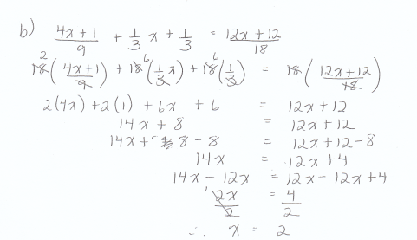
Solving Equations involving fractions and decimals
Examples:
Notes:
21

Slide 22
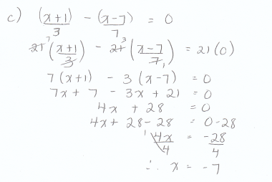
Solving Equations involving fractions and decimals
Examples:
Notes:
22

Slide 23
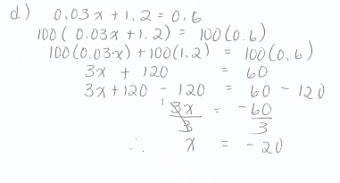
Solving Equations involving fractions and decimals
Examples:
Notes:
23

Slide 24
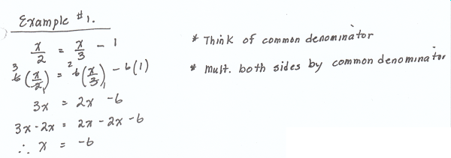
Solving Equations involving fractions and decimals
Examples:
Notes:
24

Slide 25
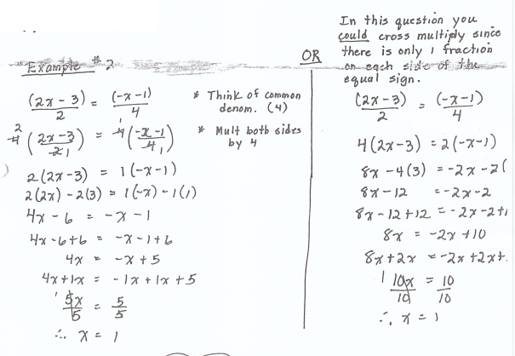
Solving Equations involving fractions and decimals
Examples:
Notes:
25

Slide 26
Assessment
Pages
103
Numbers
26 – 40 evens

Slide 27
Extra Practice
“Rolling Review”
Relay: Expressions and Equations

Slide 28
Graphing Solution Sets
Sometimes we will be asked to graph the solution of a problem. When we are graphing we need to be aware of whether the solution is Integers or Rationals
Example: a) Graph {x x > 3, x I }
a) Graph {x x > 3, x Q }
Notes:
28

Slide 29
Graphing Solution Sets
Sometimes we will be asked to graph the solution of a problem. When we are graphing we need to be aware of whether the solution is Integers or Rationals
Example: b) Graph {x -1 ≤ x ≤ 3, x I }
Example: c) Graph {x -5 ≤ x ≤ -2, x Q }
Notes:
29

Slide 30
Assessment
Worksheet

Slide 31
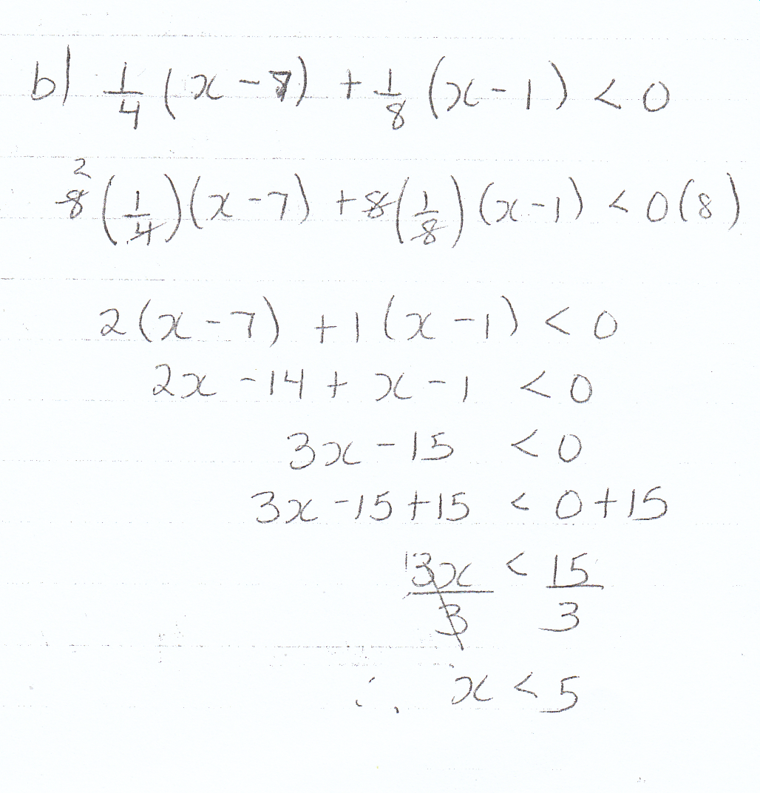
Solving and Graphing Inequalities
This is a bit of a review for solving inequalities
a) 7x + 4 ≥ 9x + 8
7x - 9x + 4 ≥ 9x - 9x + 8
-2x + 4 ≥ 8
-2x + 4 - 4 ≥ 8 -4
-2x ≥ 4
-2 -2
x ≤ -2
Notes:
31

Slide 32
Activity
Pumpkin Smash
OR
Four in a Row
Notes:
32

Slide 33
Assessment
Pages
103
Numbers
26 – 40 evens

Slide 34
Using Linear Equations to Solve Word Problems
We need to use our knowledge from the solving linear equations to solve word problems.
a) Three times a number is Twenty One
3n = 21
b) A number divided by five is seven
n = 7
5
c) Twice a number, increased by three is twenty one
2n + 3 = 21
Notes:
34

Slide 35
Using Linear Equations to Solve Word Problems
d) A rectangle has a length of 6cm and a perimeter of 28cm. Write an equation to determine the width of the rectangle.
a) Solve the equation
b) Verify the equation
Let x represent the width.
We need to use the perimeter formula from previous years.
P = 2(l) + 2(x)
28cm = 2(6) + 2x
28 = 12 + 2x
28 -12= 12 -12+ 2x
16 = 2x
6cm
Verify
28cm = 2(6) + 2x
28 = 12 + 2(8)
28 = 12 + 16
28 = 28
LS = RS
x
x
6cm
2 2
8 = x
Therefore the width is 8cm
Notes:
35

Slide 36
Using Linear Equations to Solve Word Problems
e) Seven percent of a number is Fifty Six and seven tenths.
a) Solve the equation
b) Check the solution
Let x represent the number.
We need to use our knowledge of percents from previous years
7% of x = 56.7
0.07 (x) = 56.7
Verify
7% of 810 = 56.7
.07 x 810 = 56.7
56.7 = 56.7
LS = RS
0.07
0.07
x = 810
The number is 810
Notes:
36

Slide 37
Assessment
Pages
273
Numbers
9ab, 11d, 13, 14, 15, 17

Slide 38
Solving Equations Involving Comparisons
A cell phone company offers two plans
Plan A: 120 free minutes and $0.75 per additional minute
Plan B: 30 free minutes and $0.25 per additional minutes
How much time would need to used for the same cost for both plans?
Note: For, the time you pay for is
Plan A - ( x -120)
Plan B - ( x – 30)
Let x represent the time that will result in the same cost
75(x -120) = 25(x -30)
75x - 9000 = 25x - 750
75x = 25x + 8250
50x = 8250
x= 165
The cost would be the same when the time is 165 minutes
+9000 +9000
-25x -25x
÷50 ÷50
Notes:
38

Slide 39
Assessment
Pages
281
Numbers
12, 13, 14, 15, 18

Slide 40
Solving Word Problems Using Inequalities
Start by translating inequality statements
Example:
Define a variable and write an inequality to describe each.
a) Contest entrants must be at least 18 years old
x ≥ 18
b) The temperature has been below -5⁰c for the last week
x < -5ºc
c) You must have 12 items or less to use the “Express” at the grocery store
x ≤ 12
Notes:
40

Slide 41
Solving Word Problems Using Inequalities
Example:
Jake plans to board his dog at a kennel while he is away.
Kennel A: $90 plus $5 / day
Kennel B: $ 100 plus $4 / day
For how many days must Jake board his dog so that Kennel A will be less expensive than Kennel B
Solution: Let x represent the number of days that Kennel A < Kennel B
$90 + 5x < $100 + 4x
5x < 10 + 4x
x < 10
-90 -90
-4x -4x
Therefore, Kennel A is less expensive if Jake leaves his dog their for less than 10 days.
Notes:
41

Slide 42
Assessment
Pages
292 (# 9)
299 ( # 7, 12, 13, 14)
305/6 ( #10, 13, 15)

Slide 43
Solving Problems Using Equations
The key to solving problems using equations is to properly convert the English language into math symbols.
For example the words:
Notes:
43

Slide 44
Solving Problems Using Equations
Example 1:
Find 3 consecutive numbers whose sum is 171.
To solve this you need to determine which of the 3 numbers is going to be ‘x’, and you need to know that consecutive means in a row.
Let x represent the smallest number
Let x + 1 represent the middle number
Let x + 2 represent the largest number
(x) +(x+1) + (x+2) = 171
3x + 3 = 171
-3
-3
So in this case
The first number is 56
The second number is 57
The third number is 58
3x = 168
÷3
÷3
x = 56
Notes:
44

Slide 45
Solving Problems Using Equations
Example 2:
The sides of a triangle are 3 consecutive numbers. The perimeter of the triangle is 54cm. How long is each side?
Let x represent the smallest side
Let x + 1 represent the middle side
Let x + 2 represent the largest side
(x) +(x+1) + (x+2) = 54cm
3x + 3 = 54cm
(x)
(x+1)
(x+2)
-3
-3
3x = 51
So in this case
The first side is 17
The second side is 18
The third side is 19
÷3
÷3
x = 17
Notes:
45

Slide 46
Solving Problems Using Equations
Example 3:
Joe has twice as many dimes as nickels. The total value is $3.50. How many nickels and dimes does he have?
Let x represent the number of nickels
Let 2x represent the number of dimes
5(x) +10(2x) = 350
5x +20x = 350
25x = 350
÷25
÷25
So in this case
There are 14 nickels and 28 dimes
x = 14
Notes:
46

Slide 47
Solving Problems Using Equations
Example 4:
A box contains 140 dimes and nickels. The total value is $11.15. How many dimes and how many nickels are there?
Let x represent the number of dimes
Let 140 - x represent the number of nickels
5(140-x) +10(x) = 1115
700 – 5x + 10x = 1115
700 + 5x = 1115
Let x represent the number of dimes
Let y represent the number of nickels
x + y = 140
10x + 5y = 1115
2 equations, so make one of the variable the same value
OR
10x + 10y = 1400
10x + 5y = 1115
-700
-700
5y = 285
y = 57
Now Subtract equations
5x = 415
÷5
÷5
x = 83
So in this case
There are 83 dimes and 57 nickels
So in this case
There are 83 dimes and 57 nickels
Notes:
47

Slide 48
Assessment
Worksheet

Slide 49
Uniform Motion Problems
In Uniform Motion Problems involve boats, trains, bicycles, canoes, jets, everything moving in all different directions.
Who will get there first?
How far apart will they be after a given amount of time?
When will one overtake the other?
All these questions can be solved using algebra.
D distance
r rate of speed
t time
D = r * t
An algebraic problem involving the use of this formula is called uniform-motion problem. This is because in Physics, the object is assumed to move with a constant rate in every second along the way. This means the object is always traveling the same speed.
Notes:
49

Slide 50
Uniform Motion Problems
Example 1) How far does a car travel if it goes for 4h at 70km/h?
D = rt
D = 70km x 4hr
Given:
r = 70km/h
t = 4h
hr
D = 280km
The car travels 280 km
Notes:
50

Slide 51
Uniform Motion Problems
Example 2) How long does a trip of 400km at 80km/h take?
D = rt
400km = 80km/h (t)
Given:
r = 80km/h
D = 400km
÷80km ÷80km
5hr = t
So it would take 5 hours to travel 400km at 80km/h
Notes:
51

Slide 52
Uniform Motion Problems
Example 3) One car left a rest centre traveling at 70km/h. One hour later, another car left the rest centre at 90km/h, traveling in the same direction as the first. How long does it take the second can to catch up with the first car?
The only thing that is the same is how far both cars drive when they catch each other.
Car 1 Car 2
D = rt D = rt
D = 70km/h (x) D = 90km/h (x-1)
D= 70x D = 90x - 90
Since D = D
70x = 90x - 90
20x = 90
x = 4.5 hours
Let x represent the hours
So in this case car 1 travels 4.5 hours and car 2 travels for 3.5 hours
Notes:
52

Slide 53
Uniform Motion Problems
Example 4) Jesse left the ranch, traveling at 20km/h. Then 1 hour later, Frank left the ranch at 25km/h to try and catch up with Jesse. How long did it take him?
Jesse Frank
Let x represent the hours
Given:
r = 20km/h
t = (x)hrs
Given:
r = 25km/h
t = (x-1)hrs
D = rt
D =20(x)
D = rt
D =25(x-1)
D = 25x -25
Since D = D
20x = 25x – 25
5x = 25
x = 5
So in this case Jesse travels 5 hours and Frank travels for 4 hours
Notes:
53

Slide 54
Uniform Motion Problems
Example 5) A plan left Montréal for Calgary, a distance of 3000km traveling at 350km/h. At the same time, a plane left Calgary for Montréal traveling at 450km/h. How far after take off did the planes pass each other? NOTE in this question TIME is the same
Cal → Mon
Given:
r = 450km/h
D = 3000 – x (km)
Mon → Cal
Given:
r = 350km/h
d = x (km)
D = rt
x =350 t
x = t
D = rt
3000-x =450 t
3000 - x = t
350
450
Since t = t
x = 3000 - x
Therefore the plan leaving Montreal has traveled 1312.5km when they pass.
350
450
450x = (350)(3000 – x)
450x = 1050000 – 350x
800x = 1050000
x = 1312.5
Notes:
54

Slide 55
Assessment
Worksheet

Slide 56
Rate of Work Problems
Problems involving determining the time it takes for more than one person to complete a task are known as rate of work problems.
Example: Jane takes 2 hours to deliver newspapers to her 125 customers. Angela delivers the same newspapers in 3 hours. How long will it take them to deliver 125 newspapers if they work together ?
Think of this: What fraction of Jane's job can be done in 1 hour – ½
What fraction can Angela do in 1 hour – 1/3
Let x represent the time the job takes if they work together.
1 x + 1 x = 1h
2 3
3 x + 2 x = 1h
Therefore it will take them 1 hour and 20 minutes.
6 6
6
6
5 x = 1h
5
6
5
x = 1 1/5
Notes:
56

Slide 57
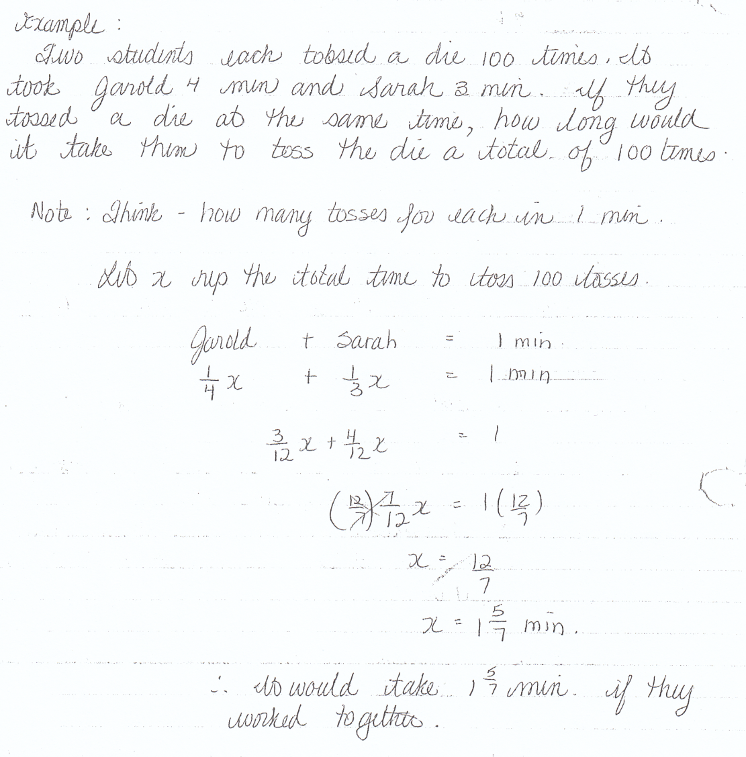
Rate of Work Problems
Notes:
57

Slide 58
Assessment
Worksheet

